Slide 1


Department of Software Engineering
Daffodil International University
A Framework to Diminish Software Development Cost by Implementing Smoke and Sanity Testing.
Title:
Presented By
Supervised By
Ibne Sayad
172-35-2115
Mr. Md. Shohel Arman
Senior Lecturer

Slide 2
Outlines
01
Background
08
Literature Review
02
Motivation
09
Methodology
03
Research Objective
10
Experimental Project
04
Problem Statement
12
Projects Result Analysis
05
Research Question
13
Result Visualization
06
Methodology Approach
0
14
Contribution
07
Testing Methodologies
15
Future work

Slide 3
Background
15-25% sometimes up to 50% spend on software testing.
(SDLC) & (STLC)
Smoke testing & Sanity Testing
Time VS Cost
1

Slide 4
Motivation
The framework will reduce the STLC time.
Reduced STLC time will reduce the SDLC cost.
More projects can be done in a minimum time.
More projects can be done in a minimum cost.
2

Slide 5
Research Objective
Smoke and Sanity testing Methodology will be used
Using those methodology I will propose a framework
Research approach will be quantitative methodology
Validate the framework
3

Slide 6
Problem Statement
Sometimes software testing cost rising up to 50% of total project cost.
A lot of extra time has been taken on STLC phase.
.
Failed to meet the deadline of the project for bad testing.
.
Software is releasing more slowly.
4

Slide 7
Research Question
How the provided framework will reduce the time?
How the provided framework will reduce the SDLC cost?
5

Slide 8
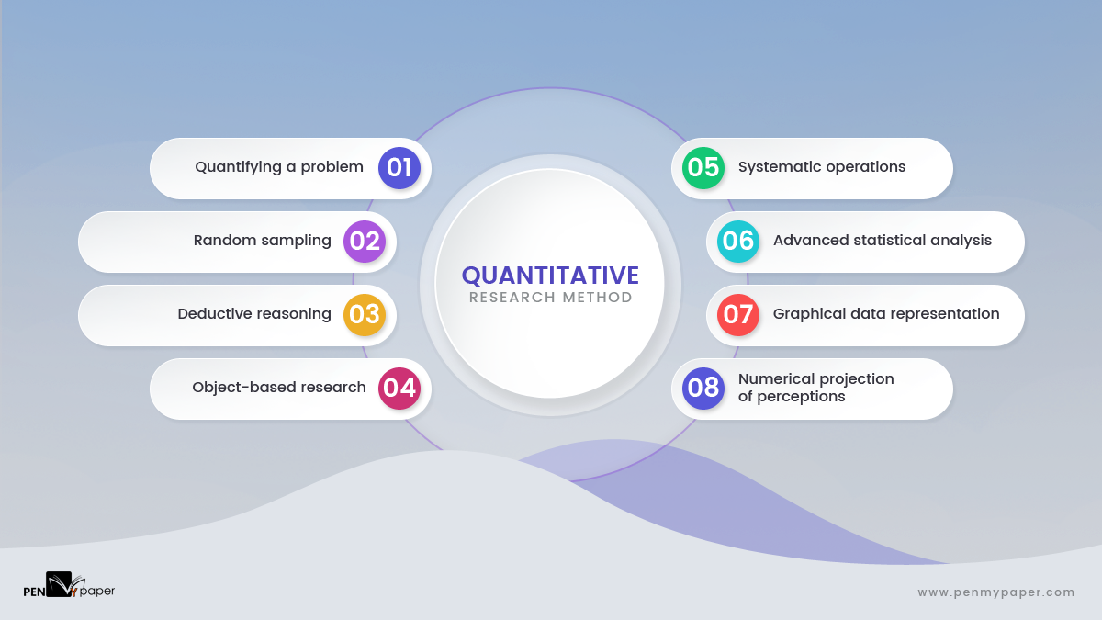
Methodology Approach
6

Slide 9
Smoke & Sanity Testing
Smoke Testing | Sanity Testing
Smoke Testing is performed to ascertain that the critical functionalities of the program is working fine. | Sanity Testing is done to check the new functionality/bugs have been fixed.
The objective of this testing is to verify the "stability" of the system in order to proceed with more rigorous testing. | The objective of the testing is to verify the "rationality" of the system in order to proceed with more rigorous testing.
This testing is performed by the developers or testers. | Sanity testing in software testing is usually performed by testers.
Smoke testing is usually documented or scripted. | Sanity testing is usually not documented and is unscripted.
Smoke testing is a subset of Acceptance Testing. | Sanity testing is a subset of Regression Testing.
Smoke testing exercises the entire system from end to end. | Sanity testing exercises only the particular component of the entire system.
Smoke testing is like General Health Check Up. | Sanity Testing is like specialized health check up.
7

Slide 10
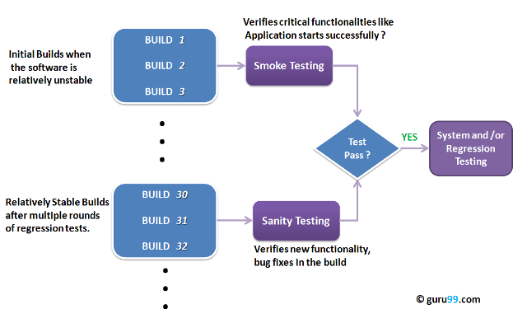
Testing Methodology
Figure: Smoke & Sanity Testing Flow
8

Slide 11
Literature Review
Author | Paper | Method | Keywords | Findings & point to improve
Rabia Sammi, Iram Masood, and Shunaila Jabeen 2017 Pakistan | A Framework to Assure the Quality of Sanity Check Process. | SCP, SCD Tensibility Matrix of SCP & SCD | Sanity check, Sanity Testing, Software Quality Assurance. | A well managed and quality sanity check not only reduces the time of overall project but also helpful in cutting off the cost of the project.
9

Slide 12
Literature Review
Author | Paper | Method | Keywords | Findings & point to improve
Chong Wang, Zhong Luo, Luxin Lin, Maya Daneva 2017 China | How to Reduce Software Development Cost with Personnel Assignment Optimization: Exemplary Improvement on the Hungarian Algorithm | Hungarian Algorithm, COCOMO, SLOC, Global Optimal Algorithm, Queue-based Grouping Algorithm, Competence-based Grouping Algorithm, | software cost estimation, personnel allocation, Hungarian algorithm, unbalanced assignment problem. | This paper improved the HA to reduce software cost through optimized personnel assignment solutions. An important direction for future work is to generalize the improved HAs in real software projects, identify other per- sonnel factors, and evaluate their in uence on our algorithms' performance.
10

Slide 13
Literature Review
Author | Paper | Method | Keywords | Findings & point to improve
Volker Gruhn Niklas Spitczok von Brisinski 2020 | How to reduce risk effectively in fixed price Software development. | PMO, FPP, FPEP, | project management, earned value management, overspend projects | We have identified a number of risks for fixed price projects and we have explained how dangerous unmanaged overspend situations can be for customers as well as for software providers.
11

Slide 14
Literature Review
Author | Paper | Method | Keywords | Findings & point to improve
Magne Jørgensen and Martin Shepperd | A Systematic Review of Software Development Cost Estimation Studies. | Regression, Regression Tree, History Based Evaluation | Systematic review, software cost estimation, software effort estimation, software cost prediction, software effort prediction, research methods. | The review identifies 304 software cost estimation papers in 76 journals and classifies the papers according to research topic, estimation approach, research approach, study context and data set.
12

Slide 15
Literature Review
Author | Paper | Method | Keywords | Findings & point to improve
JAMMEL MOHAMMED ALI MOHAMMED MONA | IMPLEMENTING SMOKE TEST TECHNIQUE ON ONLINE APPLICATION | System Study, Investigating Testing Tools, SDLC, STLC | Smoke Testing, Software Quality Assurance and Testing, Software Testing Techniques, | The primary concern of software testing revolves around the selection of testing strategy to meet the specific testing requirements. If it does not run, smoke test should be able to give us some basic diagnostics as to whether this application is down because something it depends on is not working.
13

Slide 16
Literature Review
Author | Paper | Method | Keywords | Findings & point to improve
Rijwan Khan, Mohd Amjad, | Smoke Testing of Web Application Based on ALM Tool | System Study, Investigating Testing Tools, SDLC, STLC, Rump Up | Software Testing; Perforamance Testing; Test Cases; Smoke Test; Load Test; | The primary concern of software testing revolves around the selection of testing strategy to meet the specific testing requirements. If it does not run, smoke test should be able to give us some basic diagnostics as to whether this application is down because something it depends on is not working.
14

Slide 17
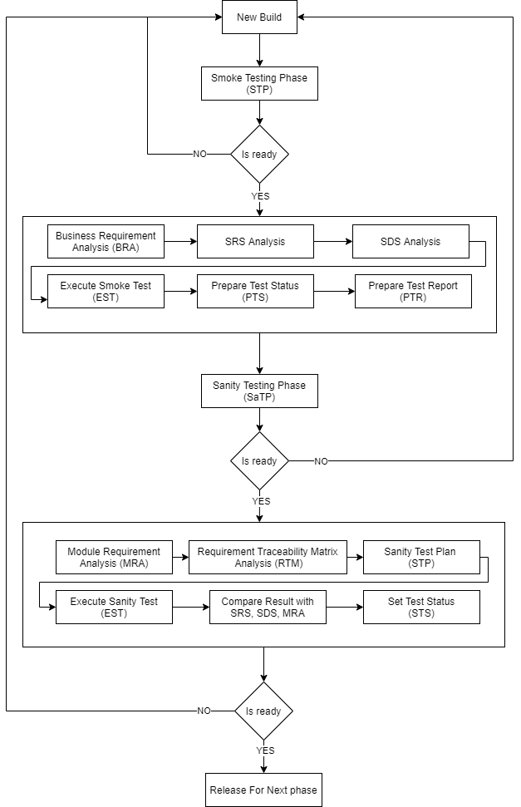
Methodology
Figure: Proposed Framework
15

Slide 18
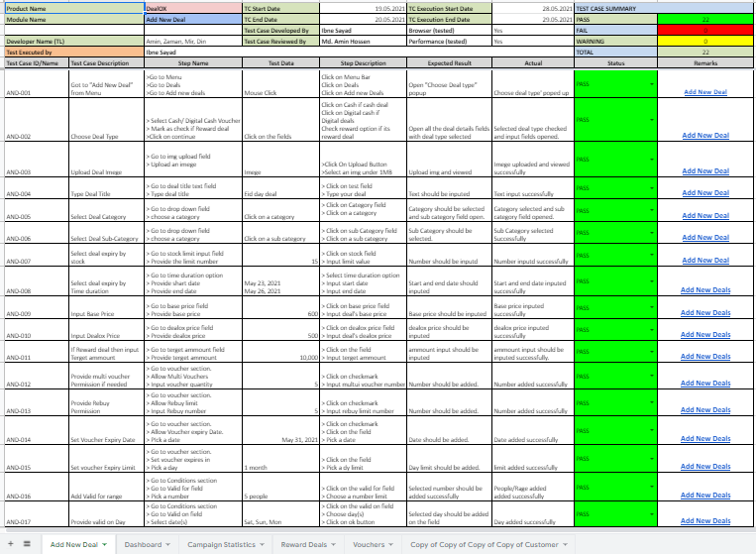
Experimental Project
16

Slide 19
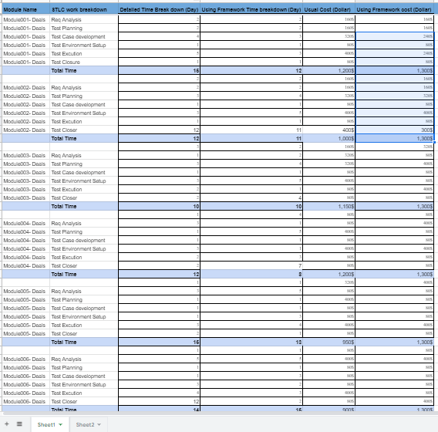
Project’s Result
17

Slide 20
Processed Result
Modules | STLC | Usual Time (WUF) | Time (UF) | Usual Cost (WUF) | Cost (UF)
Module-01 | Maintained | 15 | 12 | 1,200$ | 960$
M-02 | Maintained | 12 | 11 | 1,000$ | 840$
M-03 | Maintained | 10 | 10 | 1,150$ | 1,150$
M-04 | Maintained | 12 | 8 | 1,200$ | 900$
M-05 | Maintained | 15 | 13 | 950$ | 800$
M-06 | Maintained | 14 | 15 | 900$ | 1,000$
M-07 | Maintained | 11 | 8 | 1,150$ | 900$
M-08 | Maintained | 9 | 8 | 1,180$ | 990$
M-09 | Maintained | 10 | 8 | 1,200$ | 1,140$
M-10 | Maintained | 11 | 9 | 1,190$ | 1,120$
Total: |  | 119 | 102 | 11,120$ | 9,800$
18

Slide 21
Result visualization
19

Slide 22
Result visualization
20

Slide 23
Contribution
A framework to reduce the STLC time.
It will also improve the quality of software testing.
Way to reduce the SDLC cost.
21

Slide 24
FUTURE WORK
Integration of more testing methodologies can improve more quality of the framework.
Combination of SDLC & STLC methodologies could bring the better outcome.
Implementation on multiple project can achieve more trustworthiness of the work.
22

Slide 25
Q & A
23

Slide 26
Thank you
Sayad35-2115@diu.edu.bd
24

